Slide 1
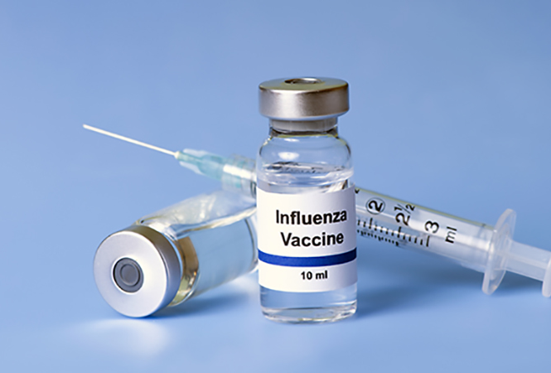

Factors Associated with Influenza Vaccination in the United States – Analysis of the 2021 CDC BRFSS
https://www.aoa.org/news/clinical-eye-care/health-and-wellness/flu-views-should-you-get-a-flu-shot?sso=y
https://www.kelsey-seybold.com/your-health-resources/blog/why-this-years-flu-season-is-different
Huong Chu and Case Keltner
HMS 520
Fall 2022

Slide 2
Outline
Flu overview
Flu vaccine importance and challenges
CDC BRFSS
Project outline
Project results
Summary

Slide 3
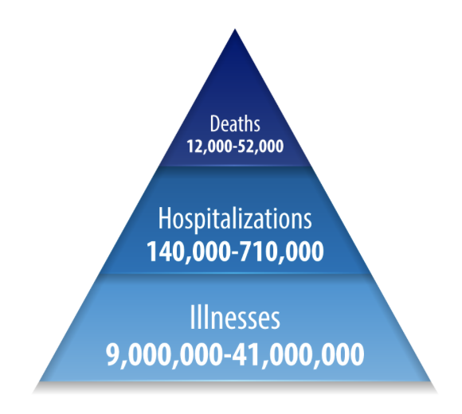
Background
Influenza (flu) is an upper respiratory viral infection that causes symptoms such as fever, muscle aches (myalgias), headache, severe malaise, cough, sore throat, and runny nose (rhinitis)
Flu contributes to significant morbidity and mortality in the United States
Figure 1. Annual Flu Burden in the US from 2010-2020
CDC. Disease Burden of Flu. 2022.

Slide 4
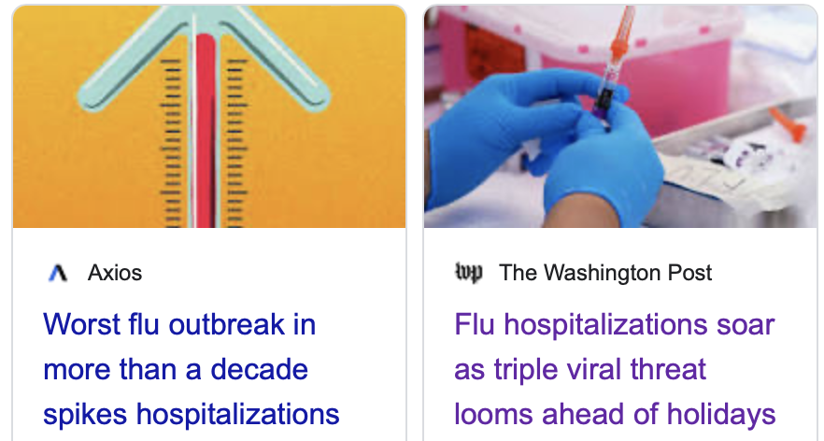
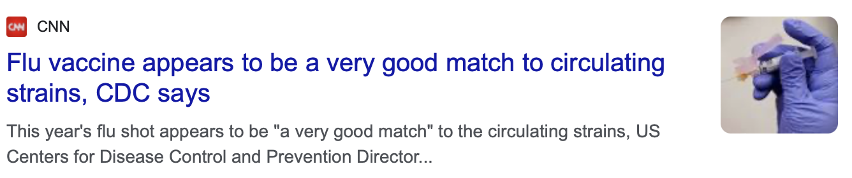
2022-2023 Flu Season

Slide 5
Flu Vaccine
Best “tool” in our toolkit against flu
Therapeutics (ex.: Oseltamivir/Tamiflu®) have been largely unsuccessful and have utility limited to select high-risk populations
Immunizing the US population against flu is a seemingly simple public health task...right?
Notes:
-Flu vaccine efficacy varies drastically from year-to-year, but it is arguably the best tool against preventing flu outbreaks, epidemics, and pandemics
-Therapeutics designed to treat flu have been largely unsuccessful to-date, and most people must simply manage symptoms using over-the-counter pharmaceuticals and home-made remedies

Slide 6
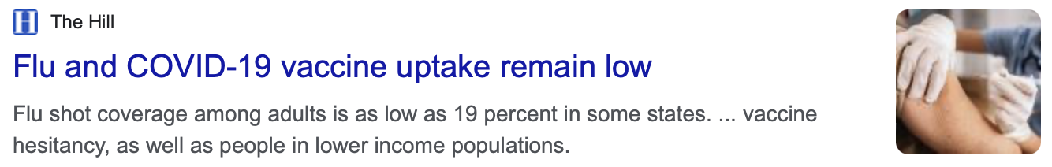
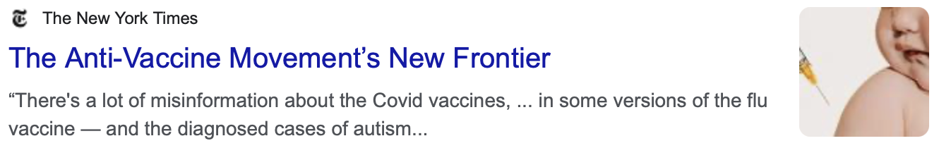
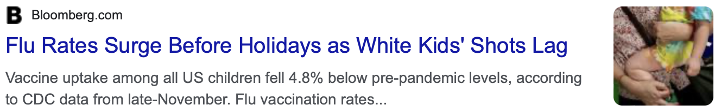
NOPE!
Notes:
As we learn time and time again, getting people immunized is a major challenge.
Flu vaccine uptake is low thus far in 2022, due to myriad reasons that would take too long to discuss in detail, but low uptake likely stems from the interplay of various elements, including misinformed beliefs (like vaccines causing autism) and political factors (decreased non-COVID vaccine uptake post-COVID vaccine mandates)
The last headline notes that uptake is low in white children too. This suggests there may be racial differences in vaccine uptake. What other differences might exist, and factors are most strongly associated with flu vaccine uptake?

Slide 7
Data Source – 2021 CDC BRFSS
Behavioral Risk Factor Surveillance System
The nation’s premier system of health-related telephone surveys
Collect data in all 50 states, DC, and 3 US territories
400K adult interviews annually (largest continuously conducted health survey system globally)
Question US residents regarding their health-related risk behaviors (ex.: smoking, physical inactivity), chronic health conditions (ex.: asthma), and use of preventive services (ex.: immunizations, cancer screening)
Nearly three-quarters of the data collected via cellphone
Notes:
To explore this question, that is, what factors are most strongly associated with flu vaccination in the United States, we used the 2021 CDC BRFSS
*Read text

Slide 8
Project Outline
Data cleaning and refactoring
Data subsetting
Descriptive analysis
Tabulated data
Plots via ggplot
Linear and logistic regression analysis
Lasso regression analysis
Provides greater prediction accuracy relative to other regression models

Slide 9
Variable | Strata
Received Flu Shot/Spray in Last 12 Months | Yes = 1 No = 2
Age years | 18-24 = 1 25-34 = 2 35-44 = 3 45-54 = 4 55-64 = 5 65+ = 6
Race | White American = 1 Black American= 2 Other races = 3 Multiracial = 4 Hispanic American = 5
Education | Less than high school = 1 High school = 2 Some college = 3 College graduate = 4
Income ($) | <15000 = 1 15000-24999 = 2 25000-34999 = 3 35000-49999 = 4 50000-99999 = 5 100000-199999 = 6 200000 = 7
Sex | Male = 1 Female = 2
Self-Reported Health Status | Excellent = 1 Very good = 2 Good = 3 Fair = 4 Poor = 5
Possess Health Insurance | Yes = 1 No = 2
Has a Healthcare Provider | Only one = 1 More than one = 2 No = 3
Last Routine Health Check-Up | Within past year = 1 Within past 2 years = 2 Within past 5 years = 3 5 or more years ago = 4 Never = 5
Marital Status | Married = 1 Divorced = 2 Widowed = 3 Separated = 4 Never married = 5 Unmarried couple = 6
Current Smoker | No = 1 Yes = 2
Current Alcohol Use | No = 1 Yes = 2
Required But Unable to See Physician in Last 12 Months Due to Cost | Yes = 1 No = 2
Urban or Rural Status | Urban counties = 1 Rural counties = 2
Asthma Status | Current = 1 Former = 2 Never = 3

Slide 10
Descriptive Statistics – Broad Overview
53.2% (n = 158,629) vaccinated
46.8% (n = 139,312) unvaccinated
Notes:
-*State vaccinated/unvaccinated total

Slide 11
Notes:
We created plots looking at proportion vaccinated along the y axis versus predictor of interest on the x axis for all predictors of interest. Some of the plots that appeared to demonstrate sizable raw differences in proportion vaccinated between strata defined by a predictor of interest were included in this presentation.
In all plots, the red bars denote vaccinated persons, while the teal plots are unvaccinated individuals
- With respect to geographic region, The northeast had the highest proportion of vaccinated individuals with over 56% of the population having received the flu vaccine. Conversely, the West had the poorest vaccine performance, with a roughly 50-50 split of vaccinated versus unvaccinated persons.

Slide 12
Notes:
- With respect to sex, females were more likely to be vaccinated, with an absolute difference in the proportion of vaccinated people over 6%

Slide 13
Notes:
-White Americans were the most likely to get vaccinated and may reflect racial disparities with respect to insurance coverage, socioeconomic status, and other confounders
-Less than 39% of the Hispanic population was vaccinated against flu

Slide 14
Notes:
- We see major disparities in vaccination coverage by insurance status, with less than 1/5th of uninsured persons having received the flu shot, compared to over half among the insured

Slide 15
Notes:
- Smokers were less likely to have received the flu shot. This is important because smokers are at high risk for development of Chronic Obstructive Pulmonary Disease (or COPD), and the flu is a major cause of COPD exacerbations that can lead to potentially fatal outcomes

Slide 16
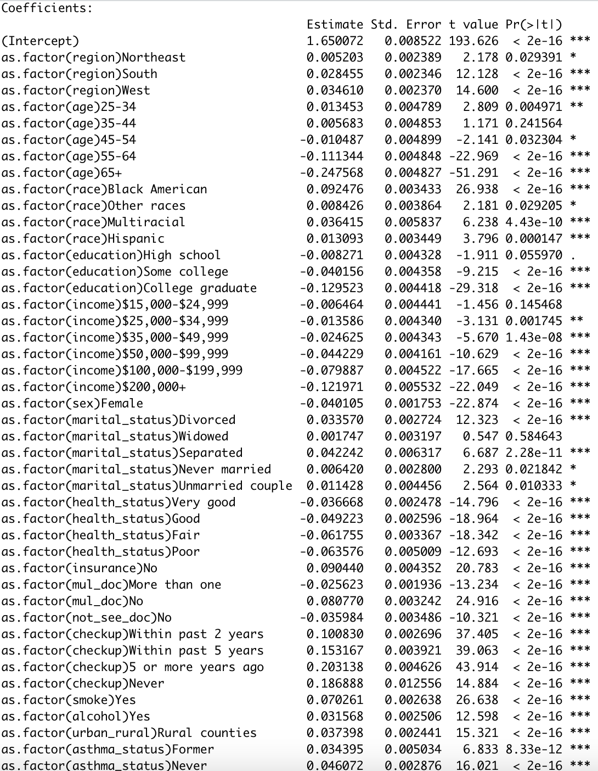
Notes:
Nearly all covariates demonstrated a statistically significant association with flu immunization status (exceptions: being widowed (relative to being married), making $15,000-$24,999 (relative to making <$15,000), being aged 35-44 years old (relative to being 18-24 years old), and having a high school degree without advanced education (relative to having less than a high school degree)).

Slide 17
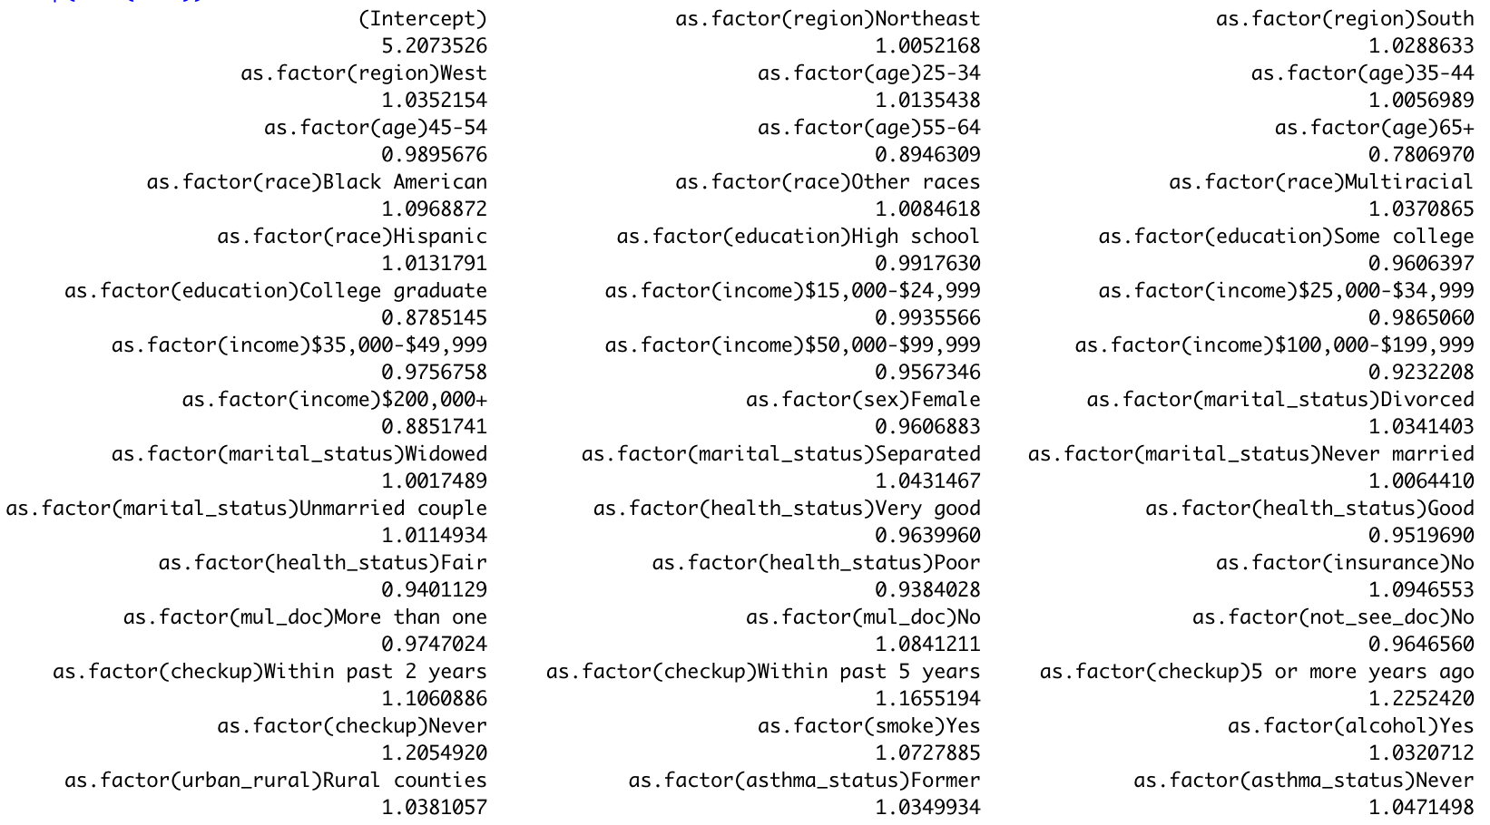
Notes:
This output depicts the stratum specific odds ratios (which were obtained by exponentiating the coefficient) from the logistic regression analysis. Numbers below one indicate decreased odds of being unvaccinated (or increased odds of being vaccinated). We some of the most noteworthy findings in boxes to make it easier to visualize. For example, college graduates had 12.1% greater odds of being vaccinated relative to those with less than a high school degree. People making >$200,000 had 11.5% greater odds of being vaccinated relative to individuals in the lowest income category. People who had never had a medical checkup had 20% greater odds of being unvaccinated relative to those with a checkup in the past 12 months. The elderly population had 22% greater odds of being vaccinated relative to the youngest age cohort (18-24 years old). Notably, odds of vaccination were greater in white individuals relative to racial minorities, and greater in females relative to males. Interestingly, odds of vaccination generally increased with decreasing self-reported health status.

Slide 18
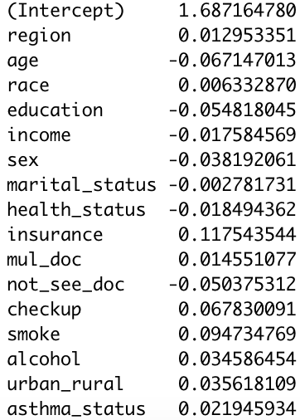
Notes:
Lasso regression was the final component of our project. We performed this to identify the set of variables that best predicts vaccination status. It induces shrinkage on the model that shrinks coefficients toward zero, and selects important covariates associated with the response variable. Without going into too much detail, we performed what is known as k-fold cross-validation to find an optimal lambda value, which is the value that minimizes the mean squared error. From there, we could determine the coefficients for the covariates of interest, which are shown on this slide.

Slide 19
Key Project Outputs
Descriptive Statistics Tables
Descriptive Statistics Plots
Linear Regression Analysis
Logistic Regression Analysis
Lasso Regression Analysis
Extensions of this in the future could involve the use of heat maps, use of other non-lasso machine learning tools, and much more!

Slide 20
Questions?

